Slide 1
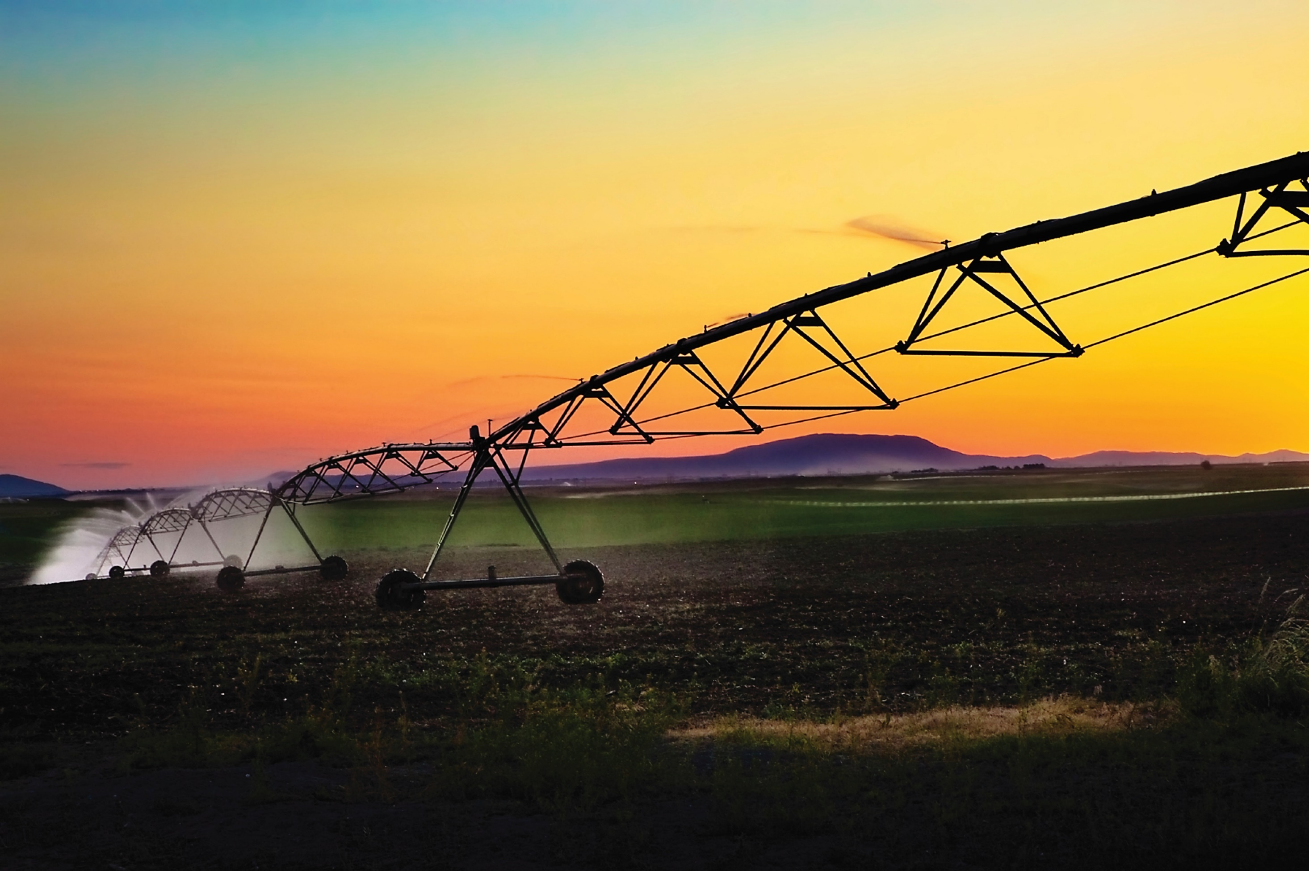
Protecting Western Slope Water in Times of Uncertainty
Andy Mueller, General Manager

Slide 2
Minding the source for more than 80 years
Created by the General Assembly in 1937
Represent Water Interests of 15 western Colorado counties
Area Encompassing 28% of Colorado
80% of the Water but only 10% of the Population
Board Representation from Each County
Funded Exclusively Through Mill Levy & Water Activity Enterprise

Slide 3
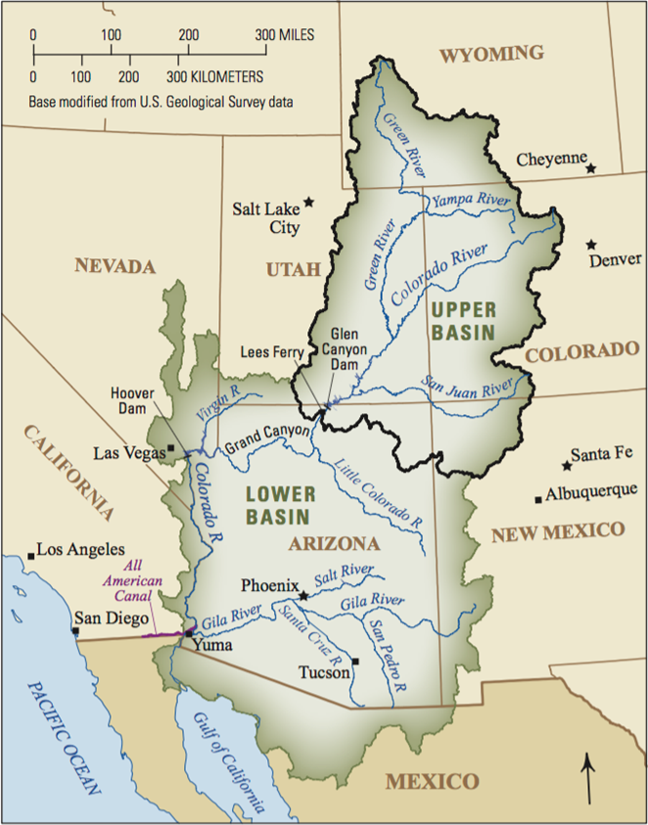
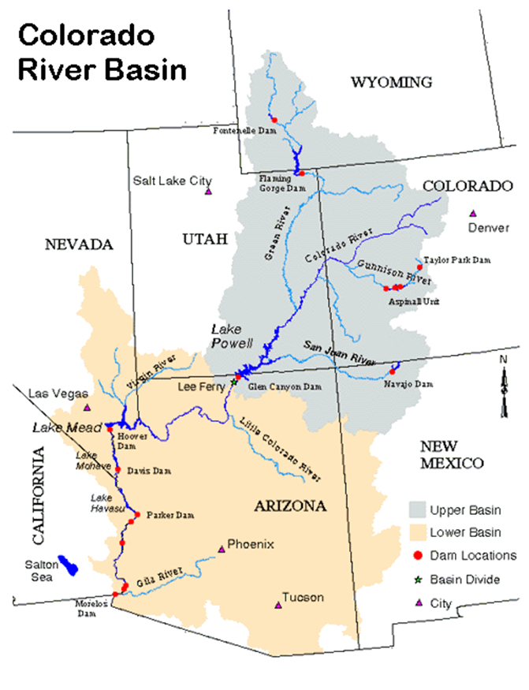
The Colorado River: On Paper
Total Allocation
= 17.5 MAF
Lower Basin
Upper Basin
7.5 MAF
Compact Allocation
7.5 MAF
Compact Allocation
1.0 MAF
Additional Compact Allocation Lower Basin
Mexico 1.5MAF
MAF = Million Acre Feet Acre Foot = 325,851 gallons

Slide 4
The Colorado River: Actual Use
TOTAL Actual Use = 16 - 17.5 MAF
Lower Basin
Upper Basin
7.5 MAF
Mainstem Uses
4 - 4.5 MAF
1.0 – 1.5 MAF
Reservoir Evaporation
.75 MAF
To Mexico
2.0 – 2.5 MAF
Tributaries
.75 MAF
To Mexico

Slide 5
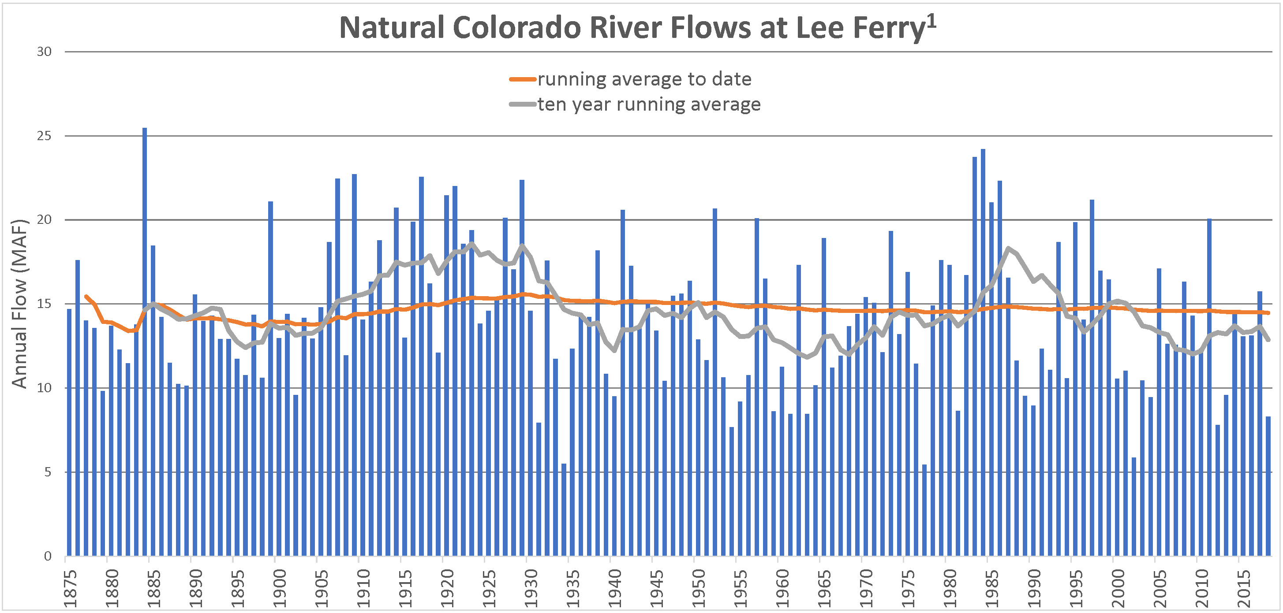
The Colorado River: Actual Water Availability
Compact Signed
¹Kuhn et al., 2019

Slide 6
Lake Powell

Slide 8
How Did We Get Here?
Lower Basin Overuse
Notes:
Lake Powell was last essentially full in 1999. This is what the last 17 years of hydrology and climate has done to the savings account. It is currently about 58 percent full. In contrast, Lake Mead is about 38 percent full right now.

Slide 9
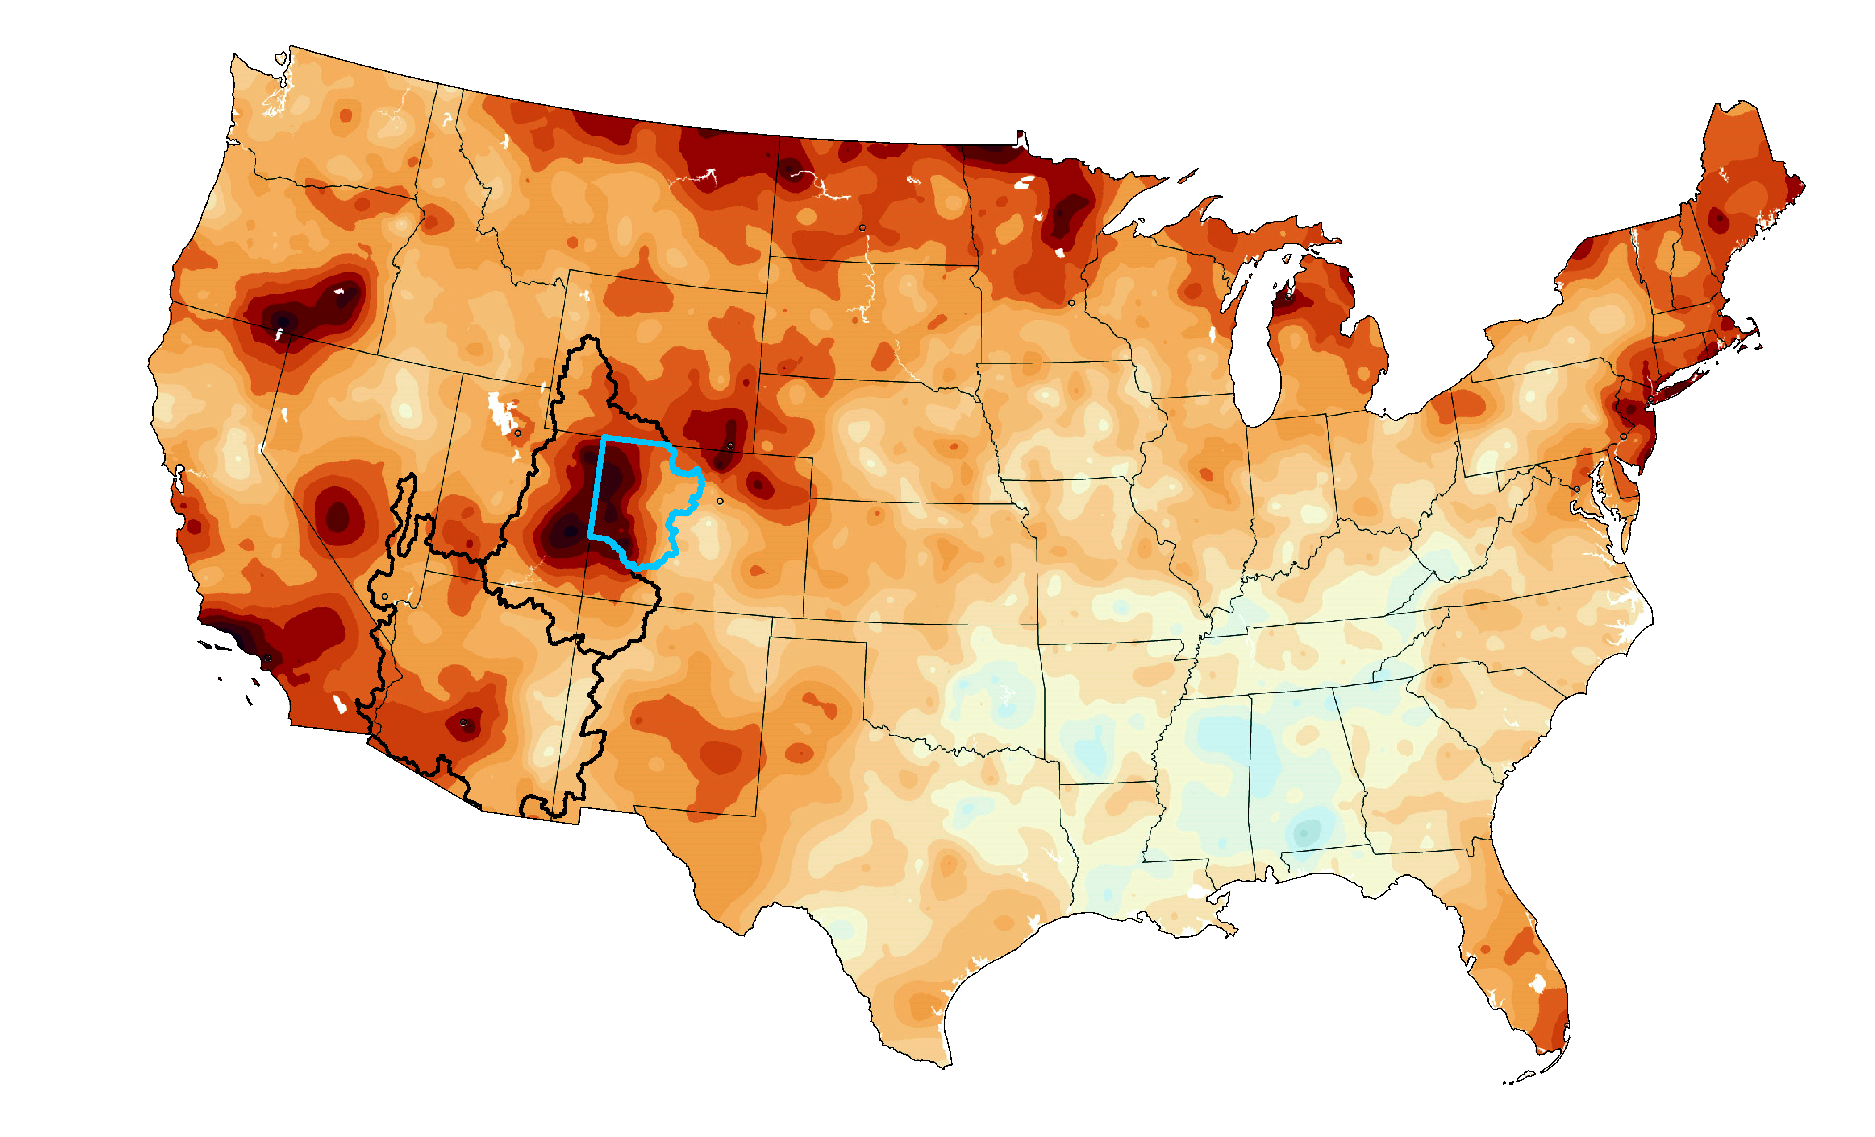
Temperature Change in the Contiguous US
Colorado River Basin
CRWCD
Temperature change, 1895-2018
-1.8 -0.9 0 0.9 1.8 2.7 3.6 4.5 5.4°F
*All temperature data generated by NOAA
temperature graphic from Washington Post "2°C: Beyond the Limit"

Slide 10
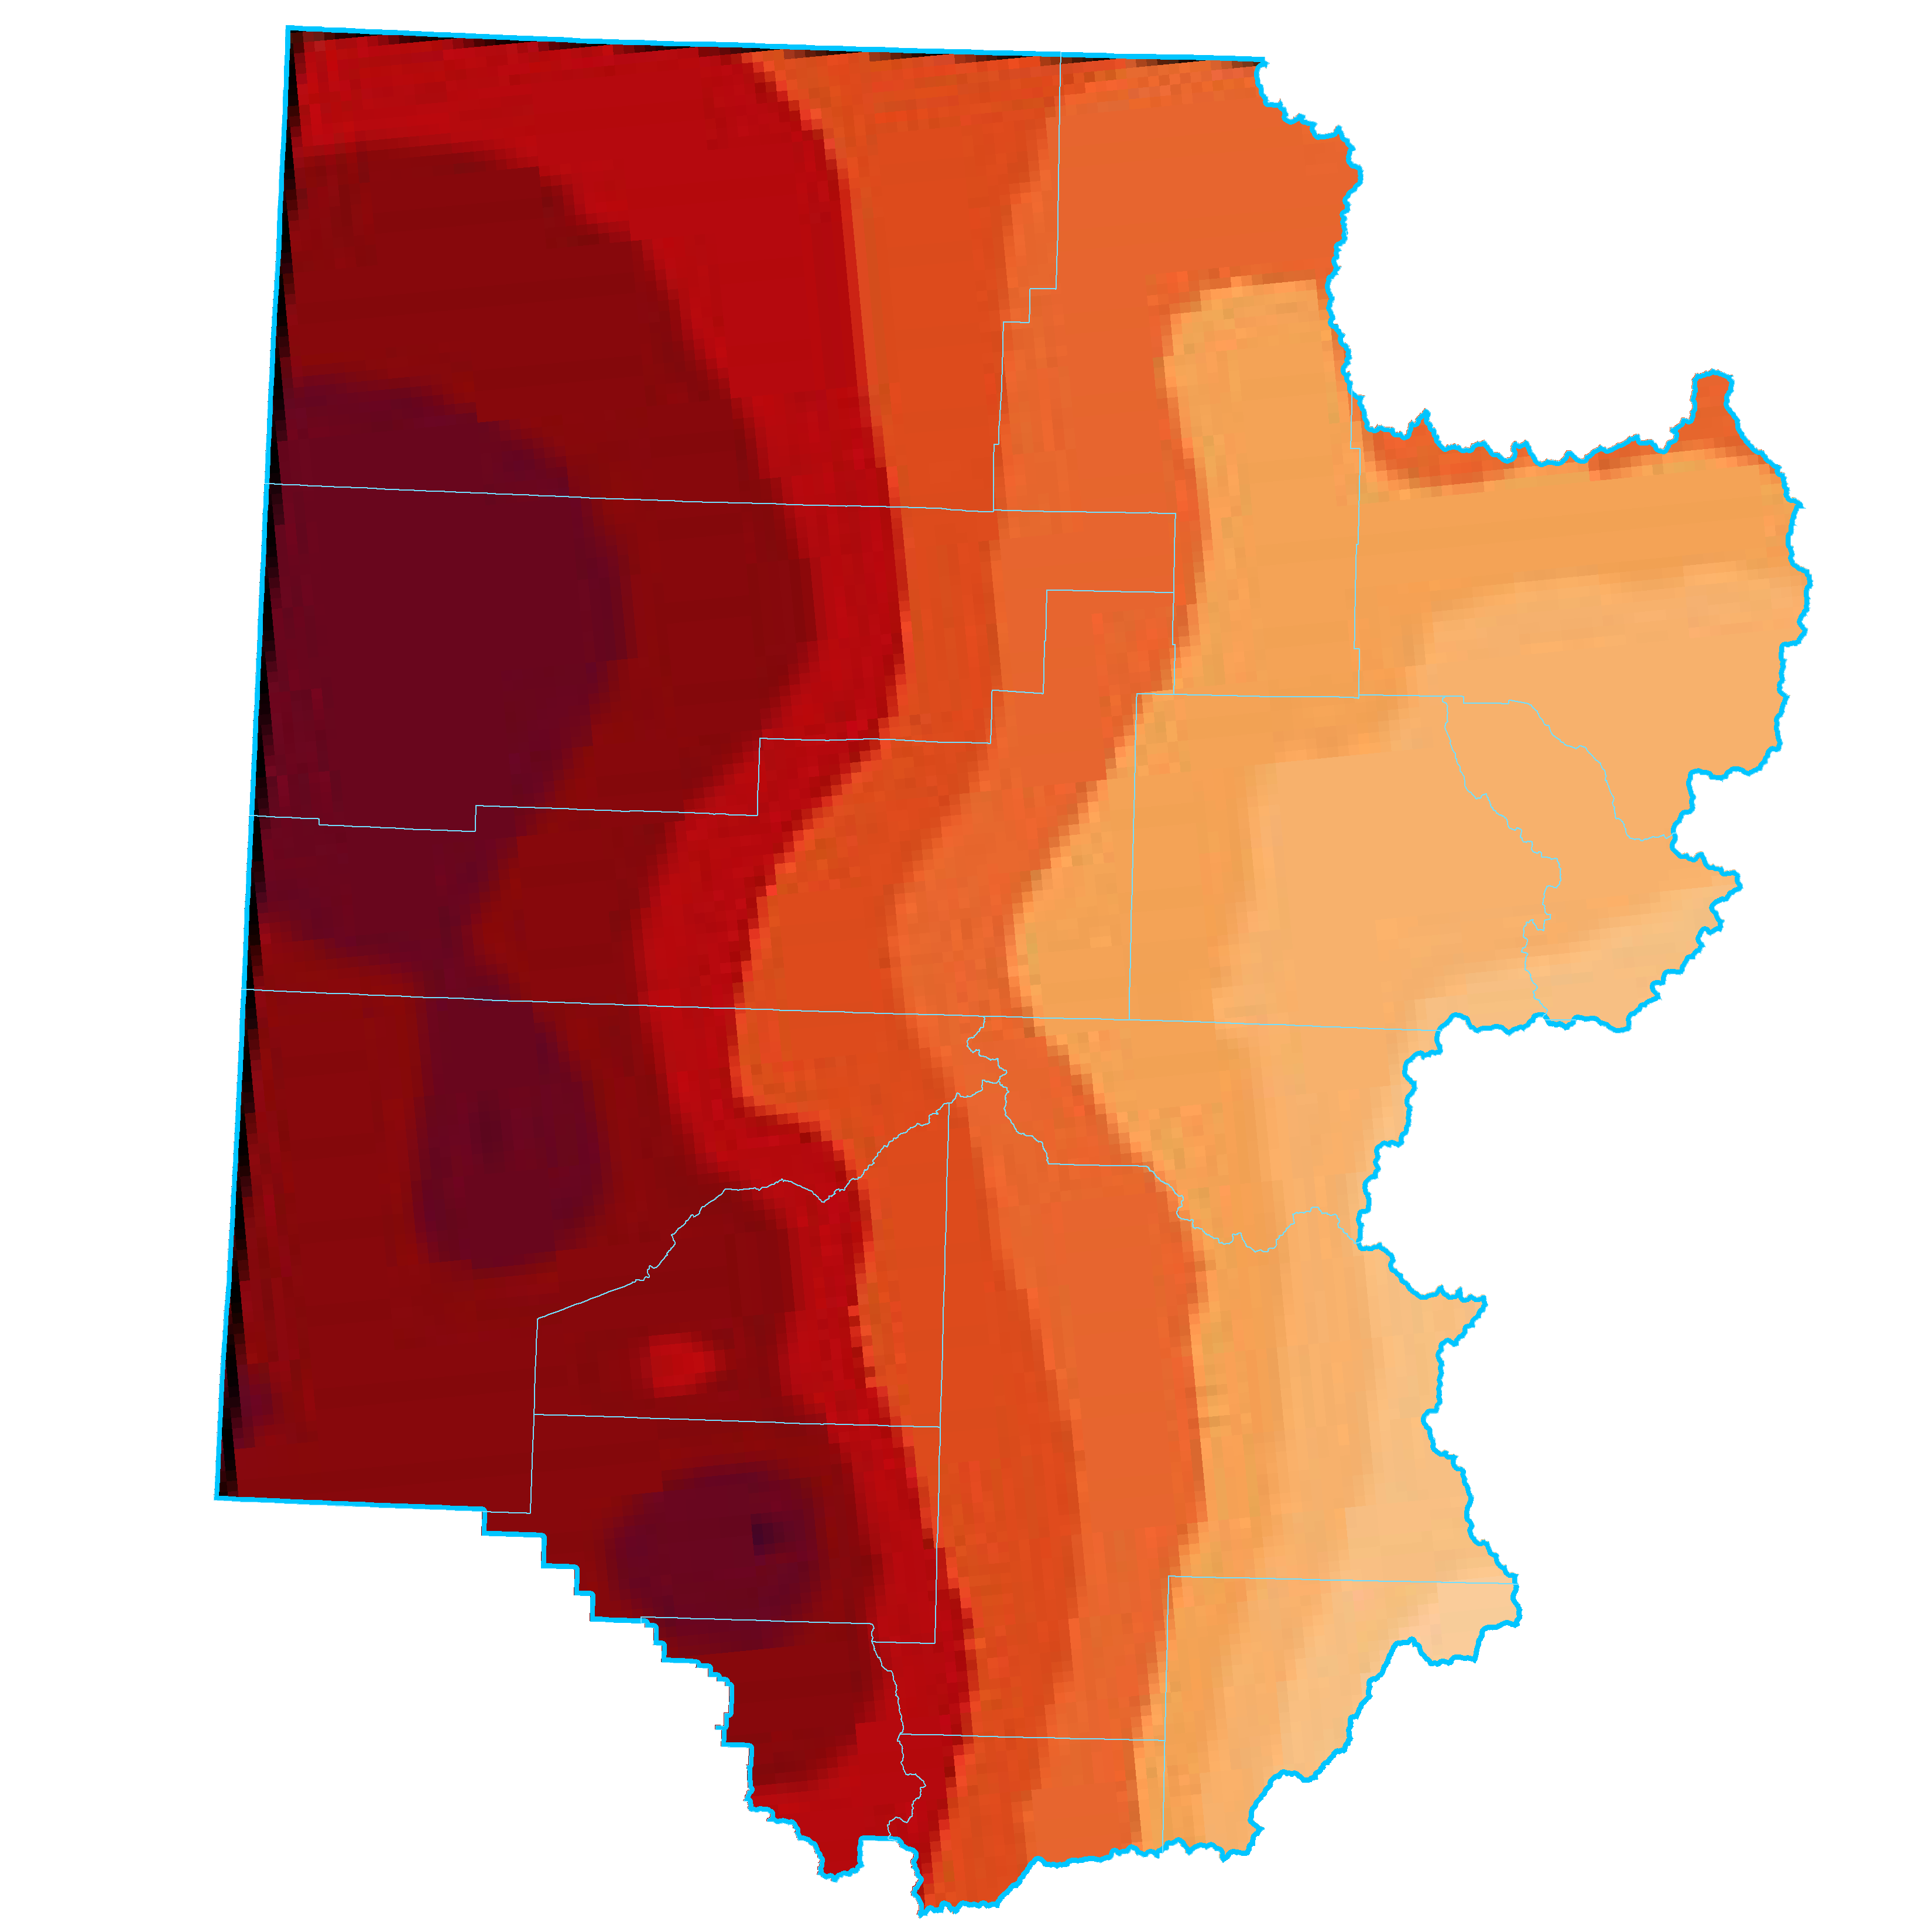
Temperature Change in the Colorado River District
Moffat
3.9°F
Routt
2.8°F
Grand
2.3°F
Rio Blanco
4.3°F
Eagle
2.2°F
Garfield
3.6°F
Summit
1.9°F
Pitkin
2.3°F
Mesa
4.2°F
Delta
3.9°F
Gunnison
2.7°F
Temperature change, 1895-2018
Montrose
4.3°F
-1.8 -0.9 0 0.9 1.8 2.7 3.6 4.5 5.4°F
Saguache
1.4°F
Ouray
4.2°F
Hinsdale
3.1°F
*All temperature data generated by NOAA
temperature graphic from Washington Post "2°C: Beyond the Limit"

Slide 11
How Warming Drives Reductions in Streamflow Berghuijs et al. (2014), Barnhart et al. (2016), Deems et al. (2013)
http://wwa.colorado.edu
More Rain Less Snow
Greater Sublimation (Direct evaporation)
Soils exposed by earlier meltout = more evaporation
Longer Growing Season = more transpiration
Most recent studies indicate ~3-4% decline in annual runoff in CO for every 1ºF of warming

Slide 12
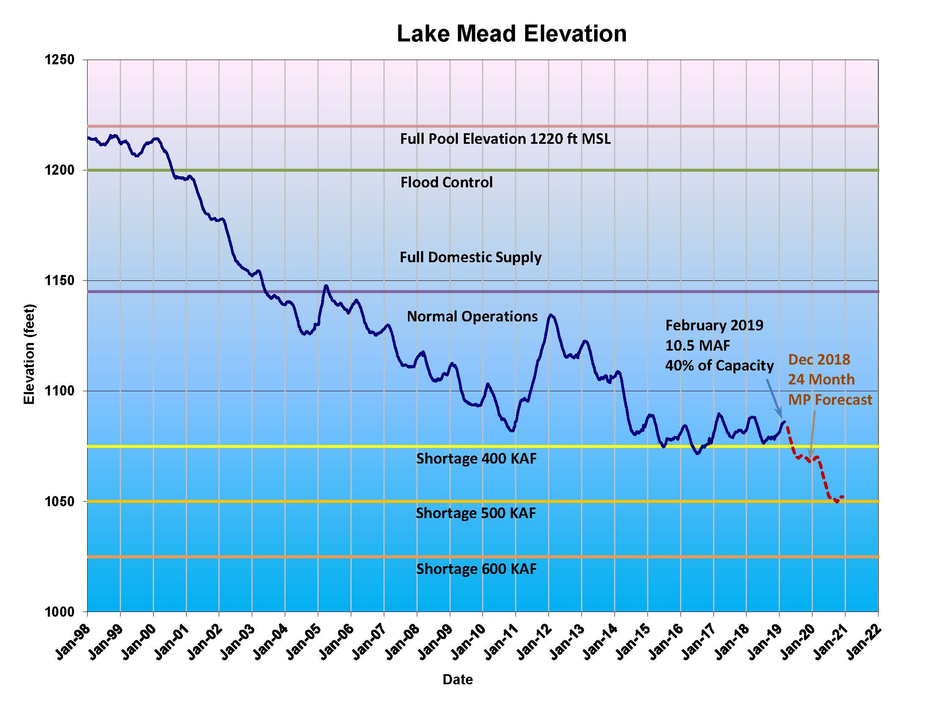
Lower Basin Drought Contingency Planning
Key Observations
Agreement to Reduce Use Depending on Levels of Lake Mead
At Lowest Levels of Lake Mead it is Equivalent to 1.1 MAF
Good Start but Not Enough to Keep the Colorado River Out of Crisis
Notes:
If Powell drops below certain levels and the Upper Basin is unable to deliver full requirement, a compact curtailment would be instituted.
The Upper Basin’s water deliveries would have to be created by curtailing (turning off) post-1922 rights.
Colorado's system of prior appropriation designates how curtailments are administered within the state. But no such process exists in the circumstance of a Colorado River compact curtailment.
Crisis situation: Potential for statewide legal and economic chaos. Uncertainty is certain.
So what is the Colorado River District doing about this. For one, it is participating in efforts to plan for continued below average hydrology. In fact, our experience now might be the new normal.
The Lower Basin is working on a plan to cut up to 1.2 maf of use. The Lower Basin is has for a long time been fully using its compact allocations.
The Upper Basin has not been using its full amount, a full amount that Mother Nature has rarely granted.
In the Upper Basin we are looking at cloud seeding, phreatophyte eradication, redeployment of stored water in the Aspinal, Navajo and Flaming Gorge reservoirs – AND, what will be most controversial: demand management.
Agricultural Water Rights Must Remain in Local Ownership.

Slide 13
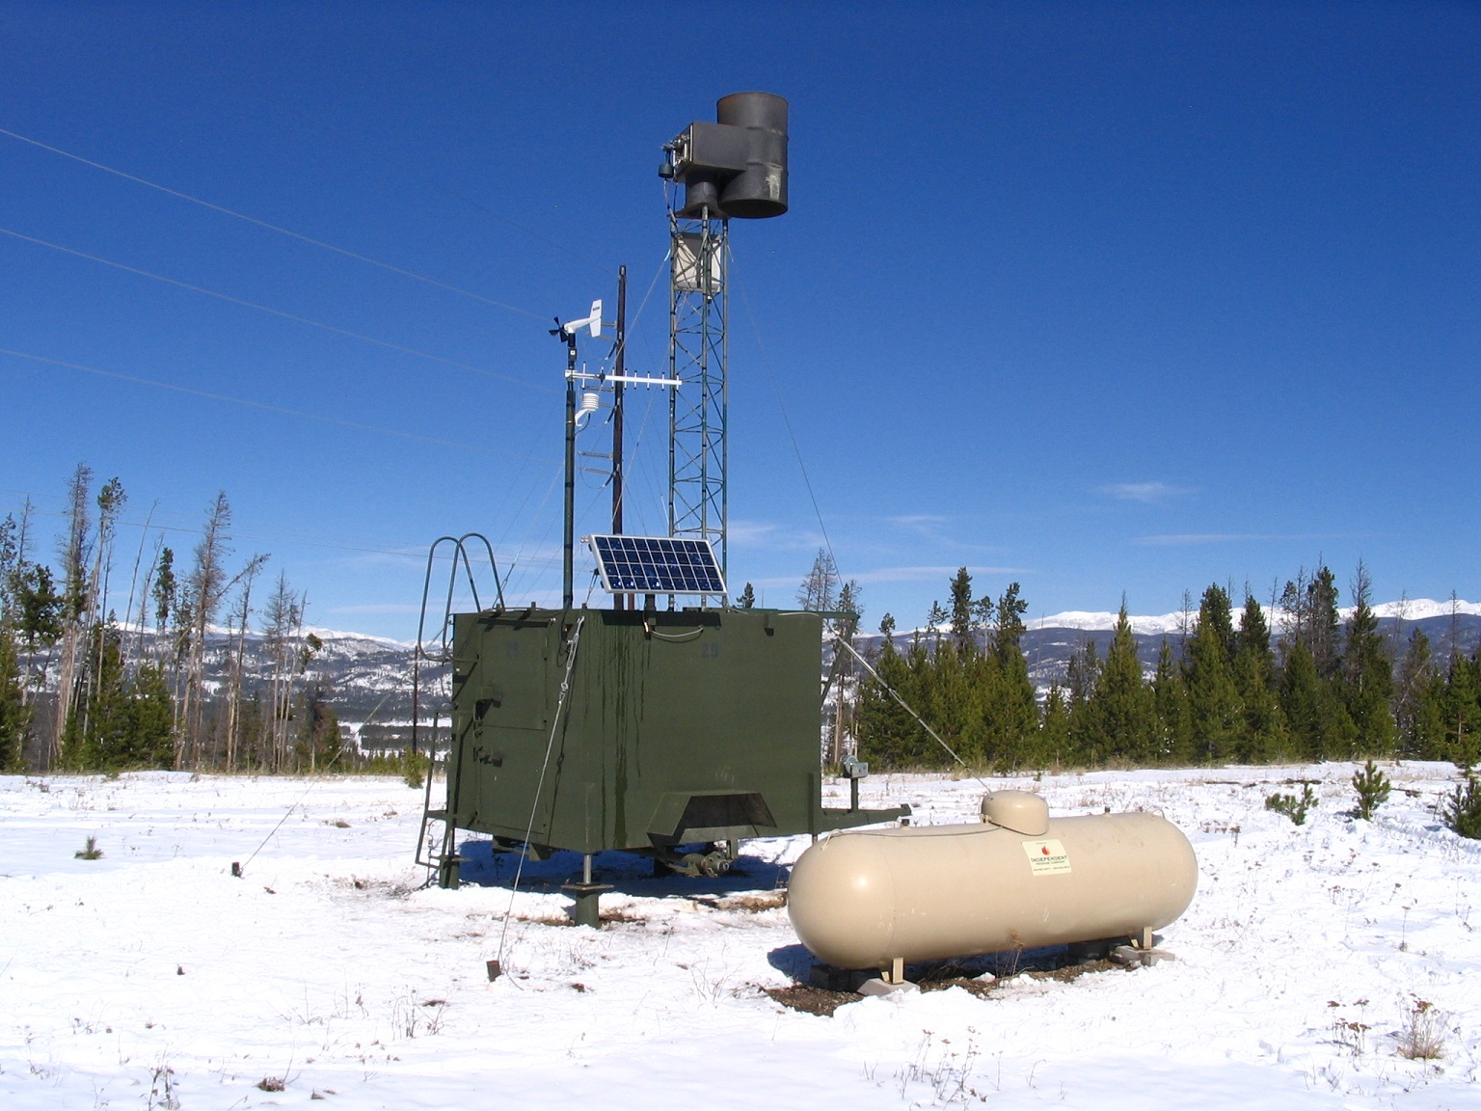
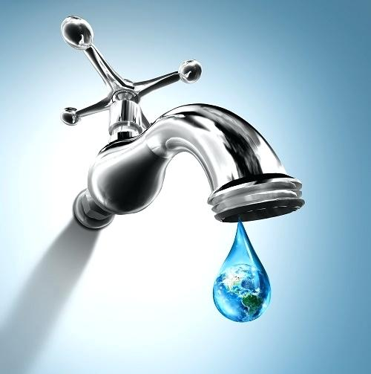
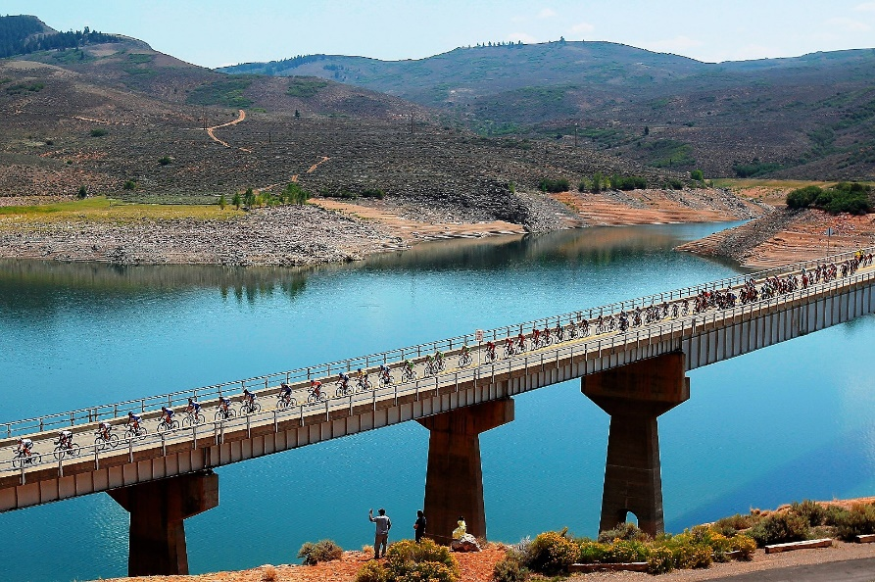
Upper Basin Drought Contingency Planning
Cloud Seeding & Phreatophyte Removal
Demand Management
CRSP Reservoir Reoperations

Slide 14
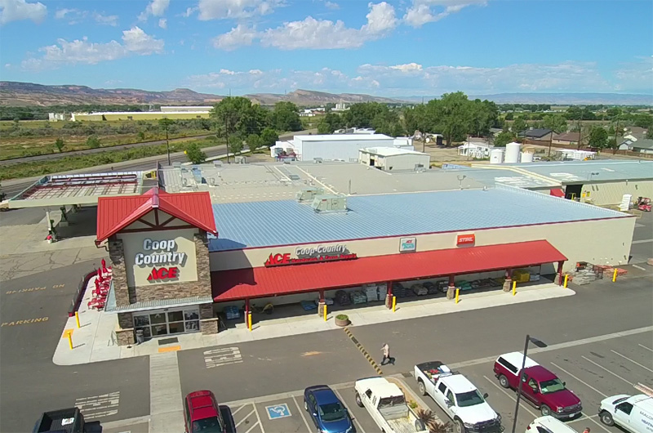
What The Colorado River District is Doing to Protect West Slope Water Users
Risk Study
Secondary Economic Impact Study
West Slope Stakeholder Process

Slide 15
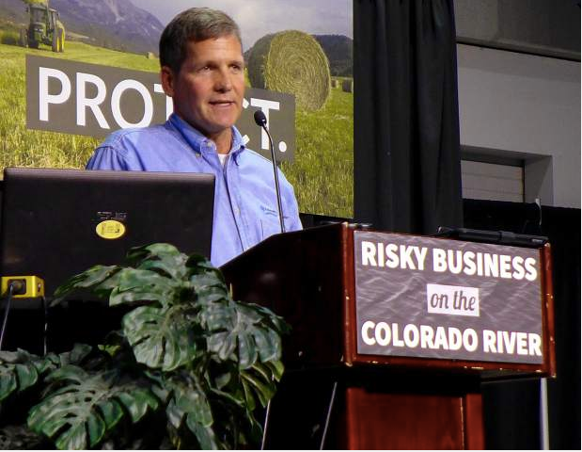
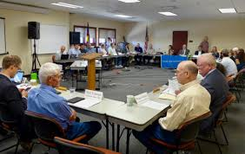
What The Colorado River District is Doing to Protect West Slope Water Users
On Farm and Off Farm Efficiencies
Advocating for Protection
Representing West Slope Interests Statewide

